Slide 1


Department of BES-I
COURSE: Data Structures
COURSE CODE: 24SC1203
Topic:
Name of the topic:
DFS
Session – 37

Slide 2



AIM OF THE SESSION
To familiarize students with the basic concept of DFS.
INSTRUCTIONAL OBJECTIVES
This Session is designed to:
Demonstrate the DFS.
Apply DFS to Real-World Problems.
Describe the each operation
List out the advantages and disadvantages with DFS.
LEARNING OUTCOMES
At the end of this session, you should be able to:
Define DFS
Describe the DFS and its operations
Summarize definition, and operations of DFS, its applications

Slide 3
DFS - INTRODUCTION
Depth-First Search (DFS) is a fundamental graph traversal algorithm used to explore all the nodes and edges of a graph. Unlike Breadth-First Search (BFS), which explores nodes level by level, DFS explores as far down a branch of the graph as possible before backtracking. It is called "depth-first" because it goes as deep as possible into the graph before retracing its steps.
DFS can be applied to both directed and undirected graphs and can be used for tasks like searching for a specific node, finding connected components, topological sorting, and solving puzzles or problems like mazes.

Slide 4
DFS Algorithm
A standard BFS implementation puts each vertex of the graph into one of two categories:
          Visited
          Not Visited
The purpose of the algorithm is to mark each vertex as visited while avoiding cycles.
The algorithm works as follows:
Step 1: Start by putting any one of the graph's vertices at the back of a queue.
Step 2: Take the front item of the queue and add it to the visited list.
Step 3: Create a list of that vertex's adjacent nodes. Add the ones which aren't in the visited list to the back of the queue.
Step 4: Keep repeating steps 2 and 3 until the queue is empty.
Step 5: The graph might have two different disconnected parts so to make sure that we cover every vertex, we can also run the BFS algorithm on every node

Slide 5
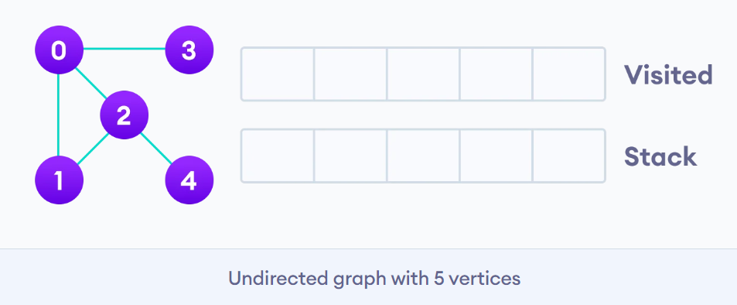
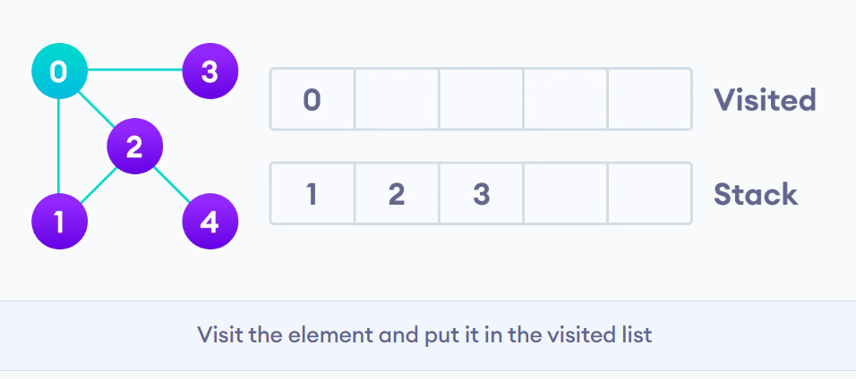
DFS Example Graph
We start from vertex 0, the DFS algorithm starts by putting it in the Visited list and putting all its adjacent vertices in the stack.

Slide 6
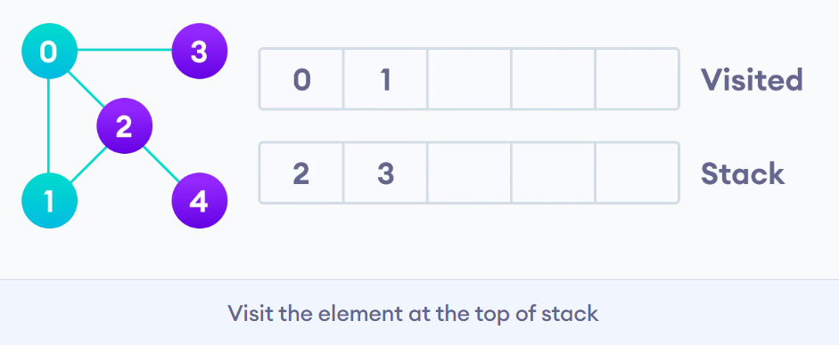
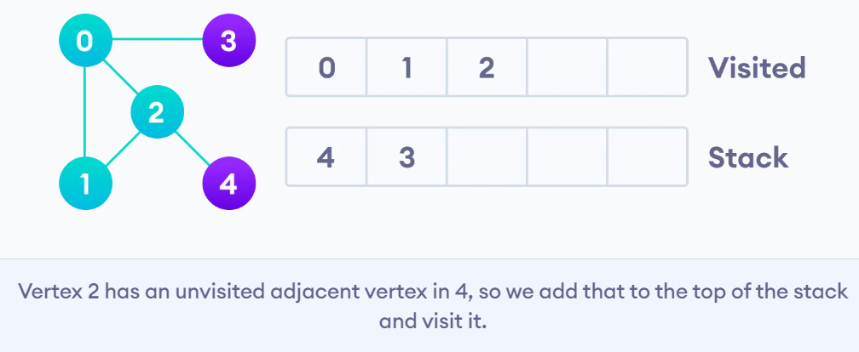
DFS Conti..
Next, we visit the element at the top of stack i.e. 1 and go to its adjacent nodes. Since 0 has already been visited, we visit 2 instead.
Vertex 2 has an unvisited adjacent vertex in 4, so we add that to the top of the stack and visit it.

Slide 7
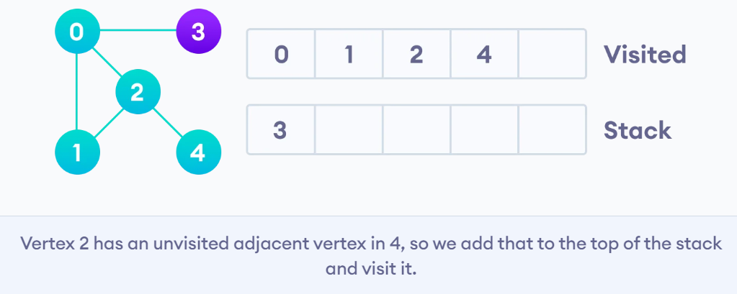
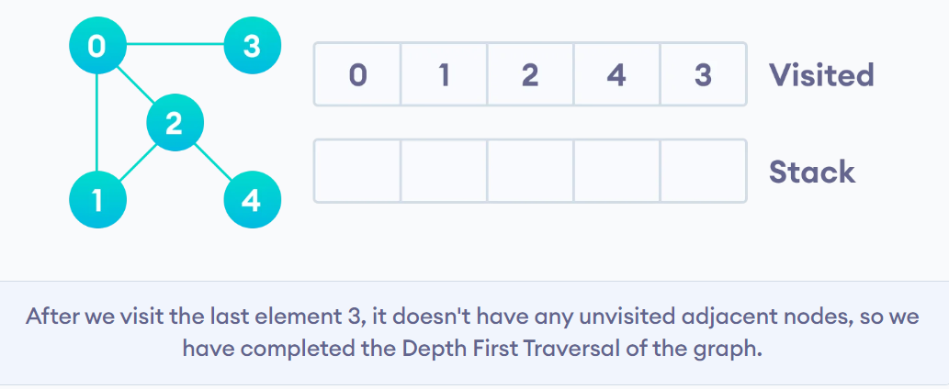
DFS Conti….
After we visit the last element 3, it doesn't have any unvisited adjacent nodes, so we have
completed the Depth First Traversal of the graph.

Slide 8
IMPORTANT FACTS RELATED TO THE SESSION-DFS
DFS Algorithm Complexity
The time complexity of the DFS algorithm is represented in the form of O(V + E), where V is the number of nodes and E is the number of edges.
The space complexity of the algorithm is O(V).
Application of DFS Algorithm
    For finding the path
    To test if the graph is bipartite
    For finding the strongly connected components of a graph
    For detecting cycles in a graph

Slide 9
a) O(E)
b) O(V + E)
c) O(V)
d) O(V^2)
a) O(E)
b) O(V + E)
c) O(V)
d) O(V^2)
a) Stack
b) Queue
c) Linked List
d) Array
a) Stack
b) Queue
c) Linked List
d) Array
a) Stack
b) Queue
c) Linked List
d) Array
a) Stack
b) Queue
c) Linked List
d) Array
SELF-ASSESSMENT QUESTIONS
1. What happens when DFS encounters a node that has already been visited?
a) It processes the node again
b) It skips the node and moves to the next unvisited neighbor
c) It stops the algorithm
d) It causes an infinite loop
2. DFS can be implemented using which of the following approaches?
a) Recursion only
b) Stack only
c) Recursion or stack
d) Queue only

Slide 10
a) O(E)
b) O(V + E)
c) O(V)
d) O(V^2)
a) O(E)
b) O(V + E)
c) O(V)
d) O(V^2)
a) Stack
b) Queue
c) Linked List
d) Array
a) Stack
b) Queue
c) Linked List
d) Array
a) Stack
b) Queue
c) Linked List
d) Array
a) Stack
b) Queue
c) Linked List
d) Array
SELF-ASSESSMENT QUESTIONS
3. Which traversal technique does DFS follow?
a) Pre-order traversal
b) Post-order traversal
c) In-order traversal
d) Level-order traversal
4. DFS is typically used for which type of graph problems?
  a)Finding shortest paths in weighted graphs
  b) Solving mazes
  c) Finding the minimum spanning tree
  d) Detecting cycles in directed graphs

Slide 11
TERMINAL QUESTIONS
Explain the Depth-First Search (DFS) algorithm and how it works?
2. What are the key differences between DFS and BFS?
3. How would you implement DFS iteratively (using a stack)?
4. What are some applications of DFS?
5. Can DFS be used to find the shortest path in an unweighted graph? Why or why not?
6. What is a "back edge" in the context of DFS, and how does it relate to cycle detection?
7. What is the time complexity of DFS for a graph with V vertices and E edges?

Slide 12
REFERENCES FOR FURTHER LEARNING OF THE SESSION
Reference Books:
  Mark Allen Weiss, Data Structures and Algorithm Analysis in C, 2010 , Second Edition, PearsonEducation.
  2. Ellis Horowitz, Fundamentals of Data Structures in C: Second Edition, 2015
  A.V.Aho, J. E. Hopcroft, and J. D. Ullman, “Data Structures And Algorithms”, Pearson Education, First Edition Reprint2003.
Sites and Web links:
1. https://nptel.ac.in/courses/106102064
2. https://in.udacity.com/course/intro-to-algorithms--cs215
3. https://www.coursera.org/learn/data-structures?action=enroll

Slide 13
THANK YOU
Team – Data Sructures

